Slide 1
Data Science Workshop
Day 2
Samarth Gupta

Slide 2
Today’s Plan
Why ML
ANN
  Artificial Neuron
  Activation function
  Single Layer Perceptron
Project: Logic Gates

Slide 3
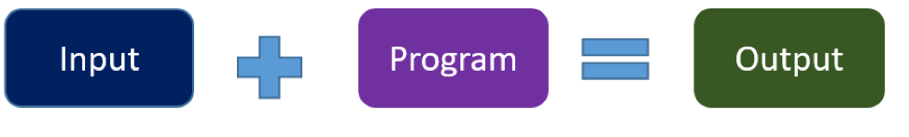
Traditional Program
VS.
Machine Learning
Traditional Programming
  Manual process— programmer creates the program.
  Without anyone programming the logic, one has to manually formulate or code rules.

Slide 4
Traditional Program
VS.
Machine Learning
Machine Learning Programming
  Automated process
  Rules may not be simple and reliable.
  Needs to combine large number of weak rules.
  Program needs to keep changing

Slide 5
Machine Learning Programming
Don’t write a program for each case
Collect lots of examples (labels) that specify the correct output for a given input (data)
Take these examples and produces a program (learning)
If we do it right, the program works for new cases (prediction) as well as the ones we trained it on (testing)

Slide 6
Artificial Neural Networks
ANN processing elements are called as neurons or artificial neurons , since they have the capability to model networks of original neurons as found in brain.
Brain | Neural Network
Neuron | Node
Connection of Neurons | Connection weight

Slide 7
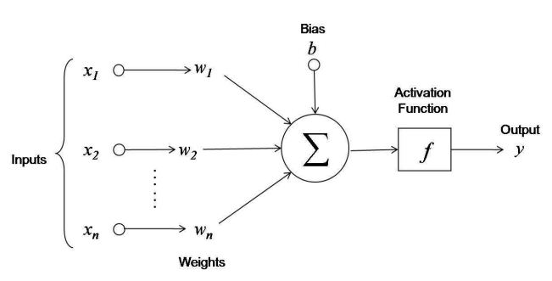
Artificial Neuron
The weighted sum of the input signal is calculated
v = w1*x1 + w2*x2 + … +wn*xn + b
The output from the activation function to the weighted sum is passed outside.
Y = f(v)
Notes:
• The circle and arrow of the figure denote the node and signal flow, respectively.
• 𝑥1 , 𝑥2 , 𝑎𝑛𝑑 𝑥3 are the input signals.
• 𝑤1 , 𝑤2 , 𝑎𝑛𝑑 𝑤3 are the weights for the corresponding signals.
• Lastly, b is the bias, which is another factor associated with the storage of information.
• In other words, the information of the neural net is stored in the form of weights and bias.

Slide 8
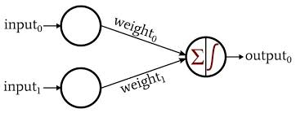
Single Layer Perceptron (SLP)
It is the simplest ANN, having input, an activation function and output
Notes:
Training Method or Learning
Supervised Learning: input, correct output
Unsupervised Learning:
Reinforcement Learning: input, some output, grade for this output

Slide 9
Learning Algorithm
Weights:
  interconnections between the neurons
  Store information of a neural network
Learning:
  updating its weights based on the loss function
  Use a learning algorithm
  Till convergence to the expected output
Notes:
Forward pass phase: computes ‘functional signal’, feed forward propagation of input pattern signals through network
Backward pass phase: computes ‘error signal’, propagates the error backwards through network starting at output units (where the error is the difference between actual and desired output values)

Slide 10
Activation Functions
Activation function is applied over the net input to calculate the output of an ANN.

Slide 11
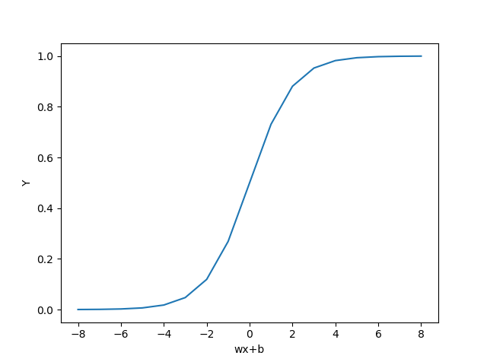

Activation function- Sigmoid
Can accept real values as input
The value of the activation is equal to the weighted sum of its inputs i.e. ∑wi*xi
b : Bias

Slide 12
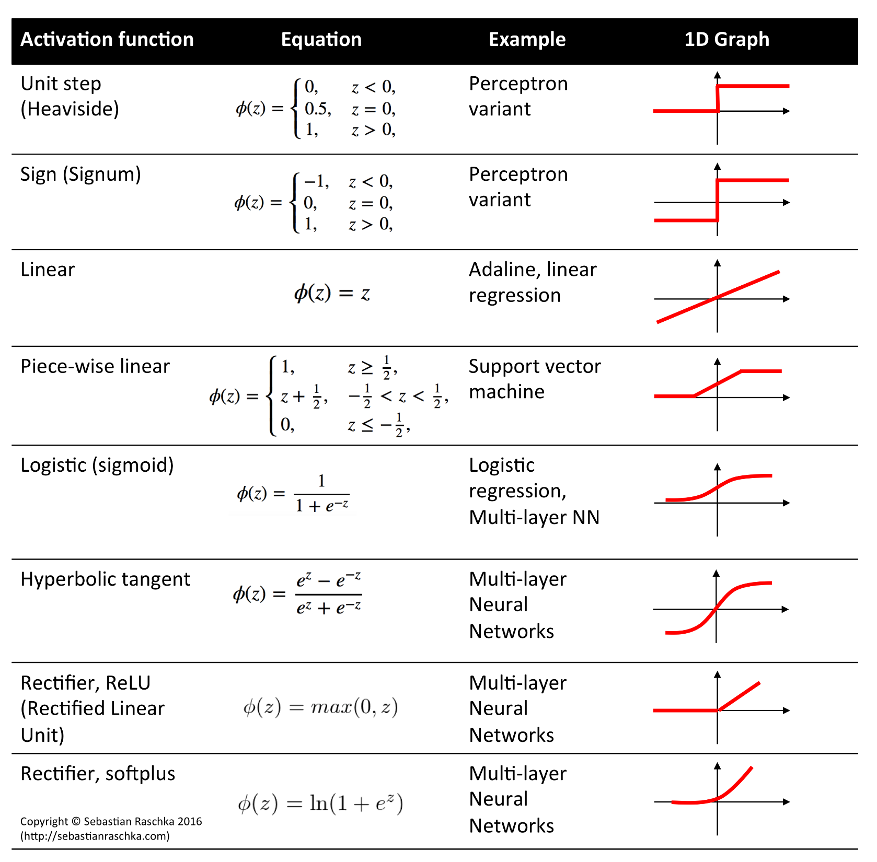
Notes:
Examples of activation function

Slide 13
Training the Perceptron
Initialize the Weights and calculate the Actual Output

Slide 14
Training the Perceptron
Define and Calculate the Error
Error=Desired Output – y
Update weights to minimize the error
Repeat

Slide 15
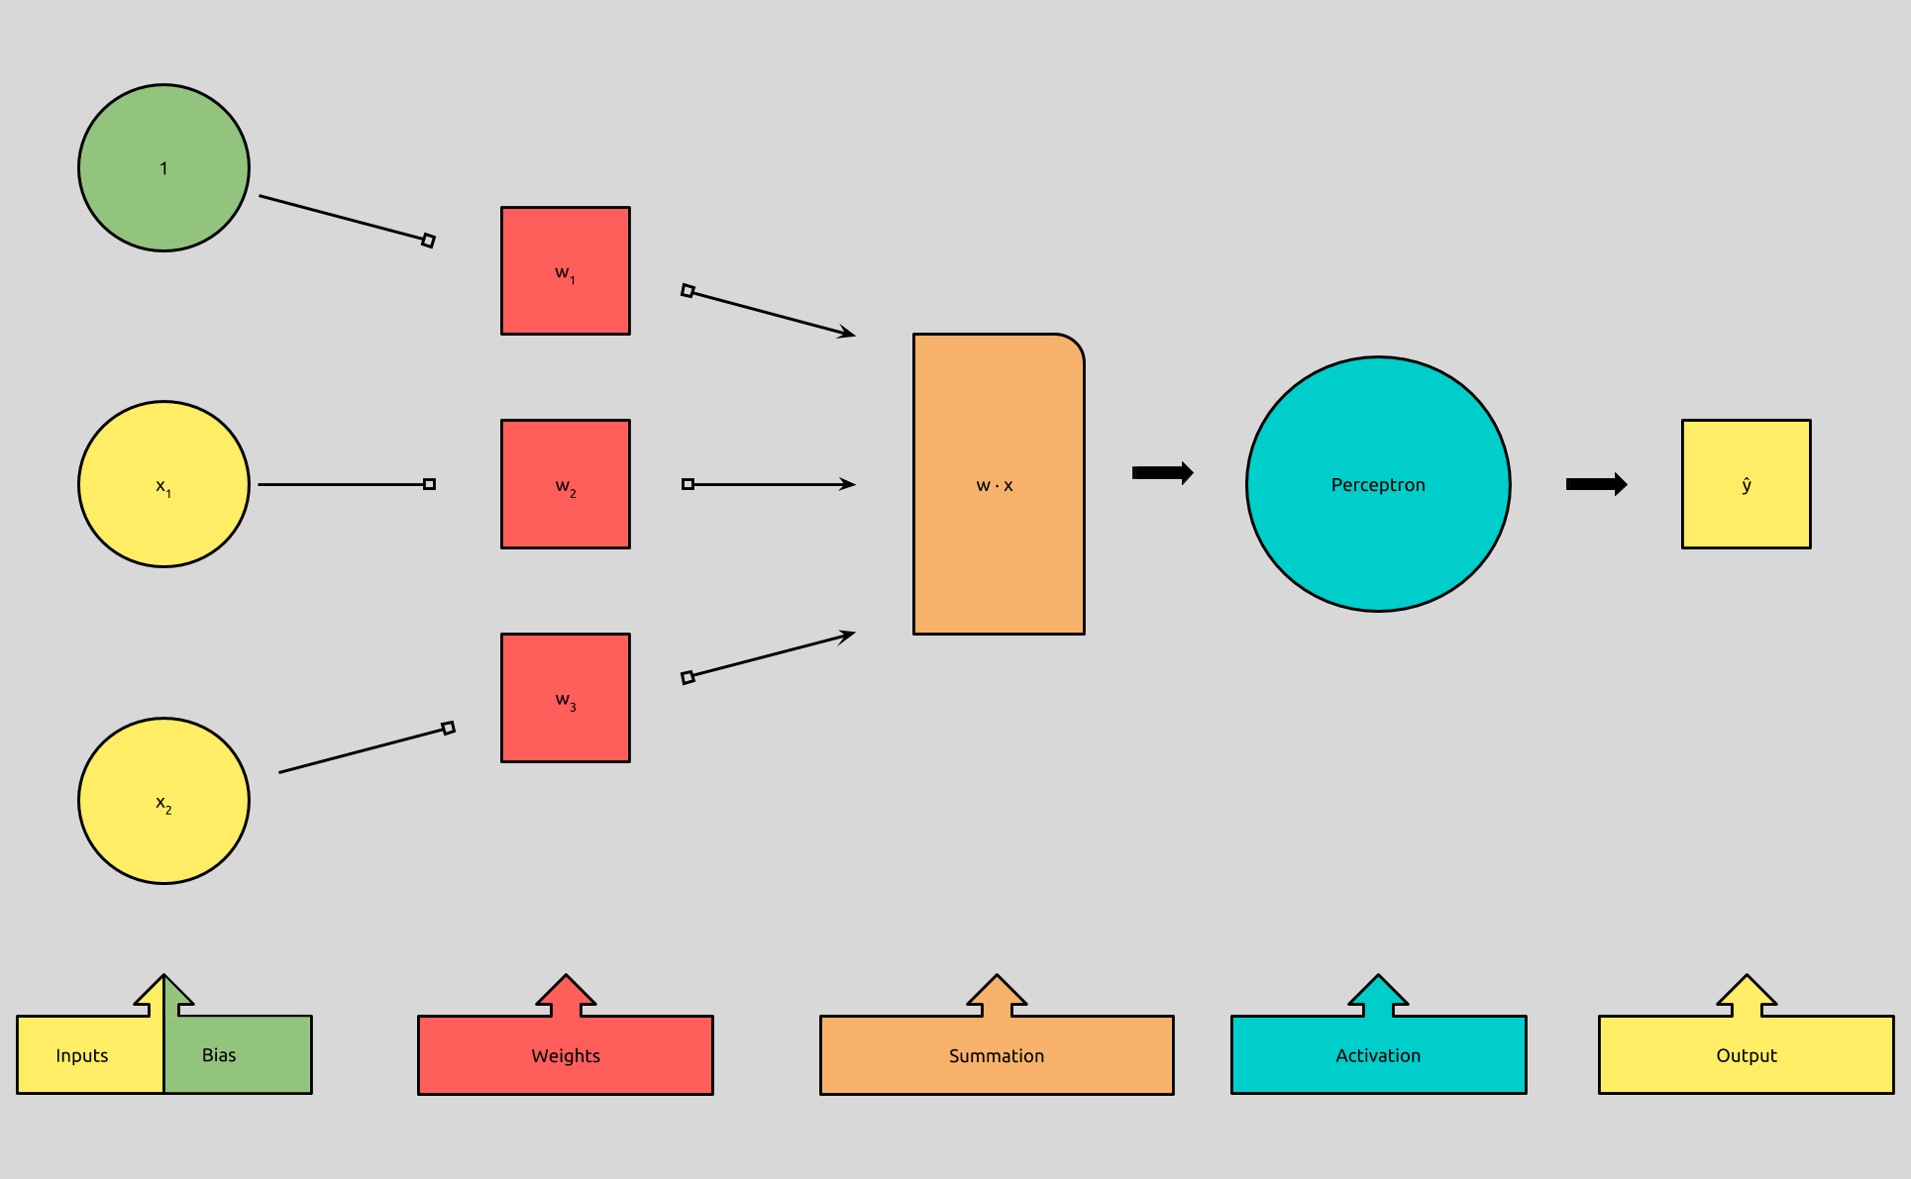
ANN for AND Gate
Python Class Perceptron

Slide 16
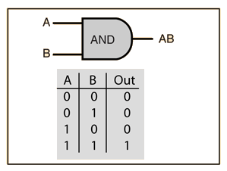
ANN for AND Gate
Initializing: w1=1, w2=1, b= –1
w1*x1+w2*x2+b = x1(1)+x2(1)–1
For Row1:
x1(1)+x2(1)–1= -1 < 0 => y=0
CORRECT
For Row2:
x1(1)+x2(1)–1= 0 == 0 => y=0
CORRECT
For Row3:
x1(1)+x2(1)–1= -1<0 => y=0
CORRECT
For Row4:
x1(1)+x2(1)–1= 1 >0 => y=1
CORRECT

Slide 17
ANN for AND Gate- Incorrect Initial Weights
Initializing: w1=0, w2=1, b= –1
w1*x1+w2*x2+b = x1(0)+x2(1)–1
For Row1:
x1(0)+x2(1)–1= 0 == 0 => y=0
CORRECT
For Row2:
x1(0)+x2(1)–1= 0 == 0 => y=0
CORRECT
For Row3:
x1(0)+x2(1)–1= -1<0 => y=0
CORRECT
For Row4:
x1(0)+x2(1)–1= 0==0 => y=0
INCORRECT
Change: To get y=1, make w1=1
Recalculate for all

Slide 18
Problem Statement
Implement ANN for the following Boolean Logic Gates and observe the accuracy
  OR
  NOT
  NAND
  NOR
  XOR
  XNOR

